Slide 1
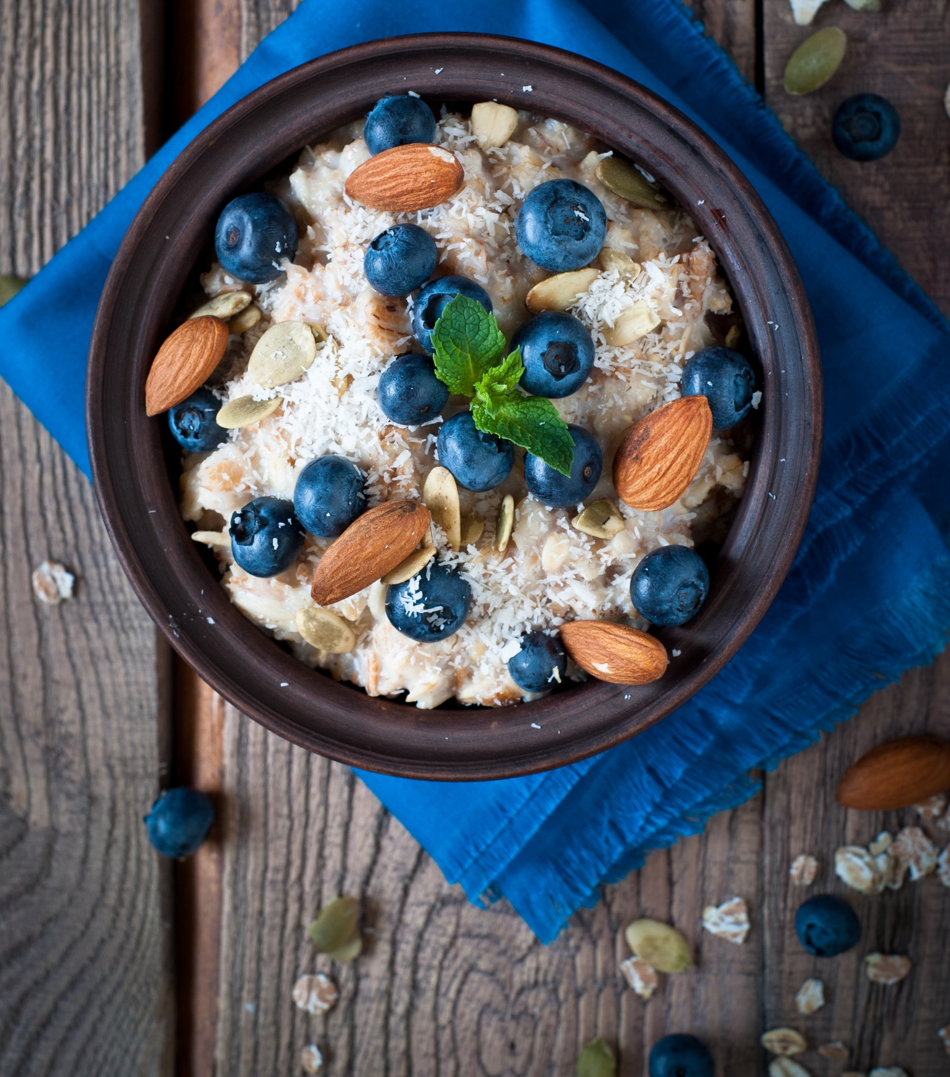
150
calories
Oatmeal with blueberries and almonds

Slide 2
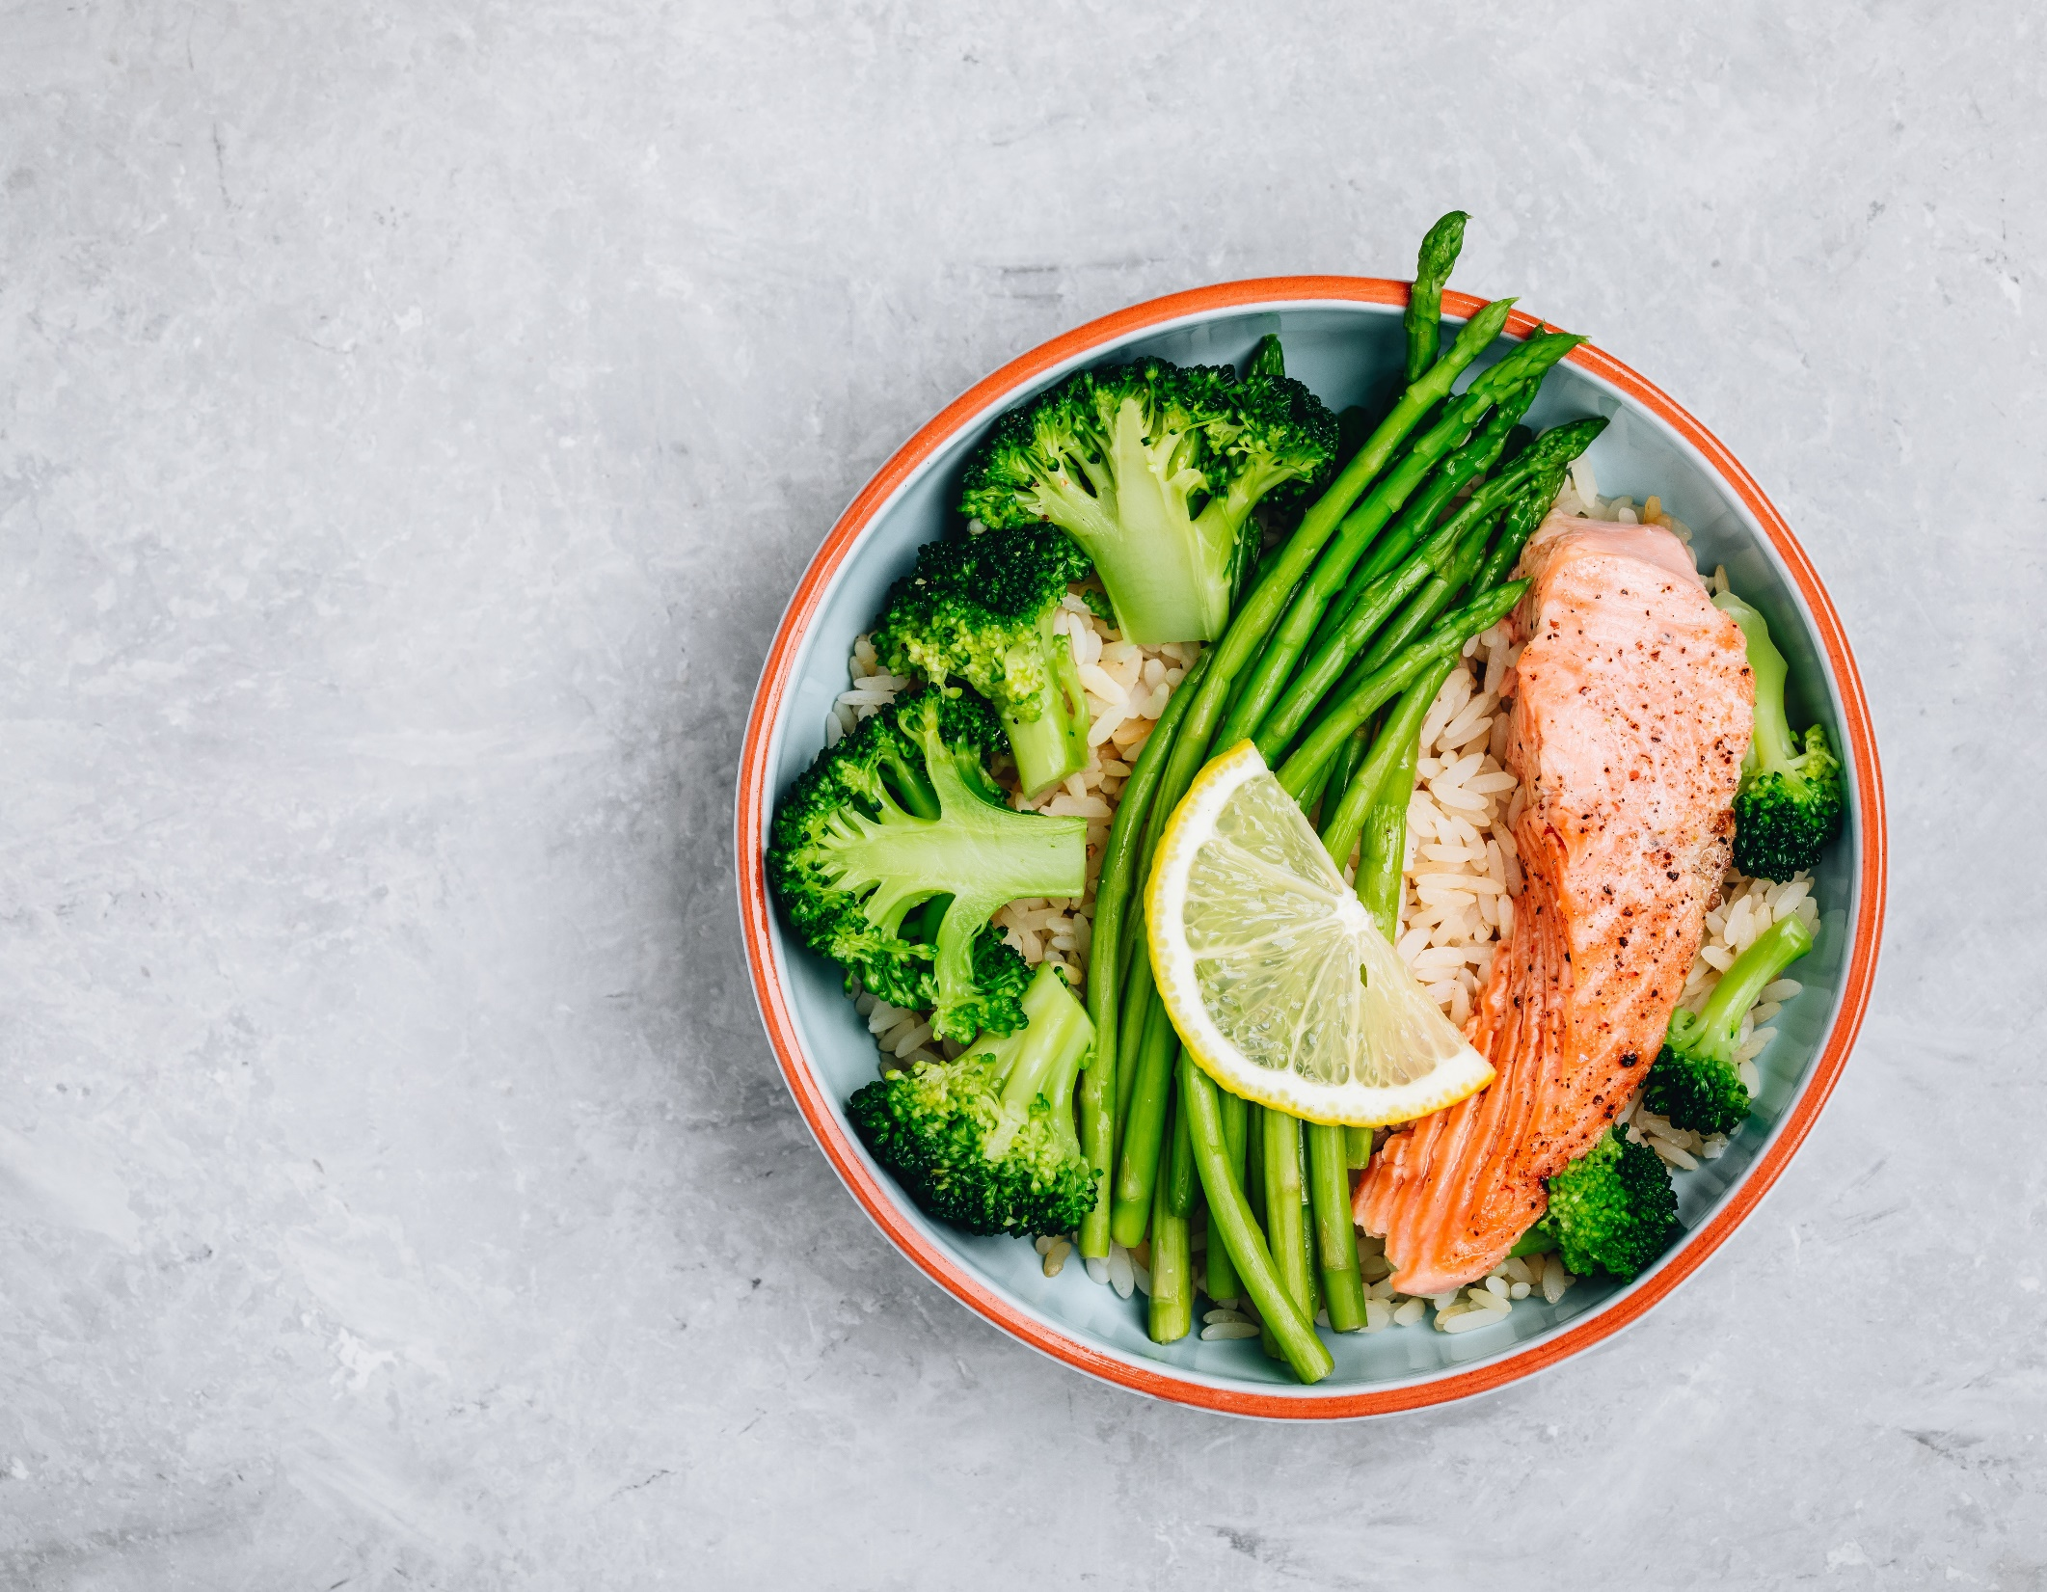
375
calories
Salmon, brown rice, and asparagus

Slide 3
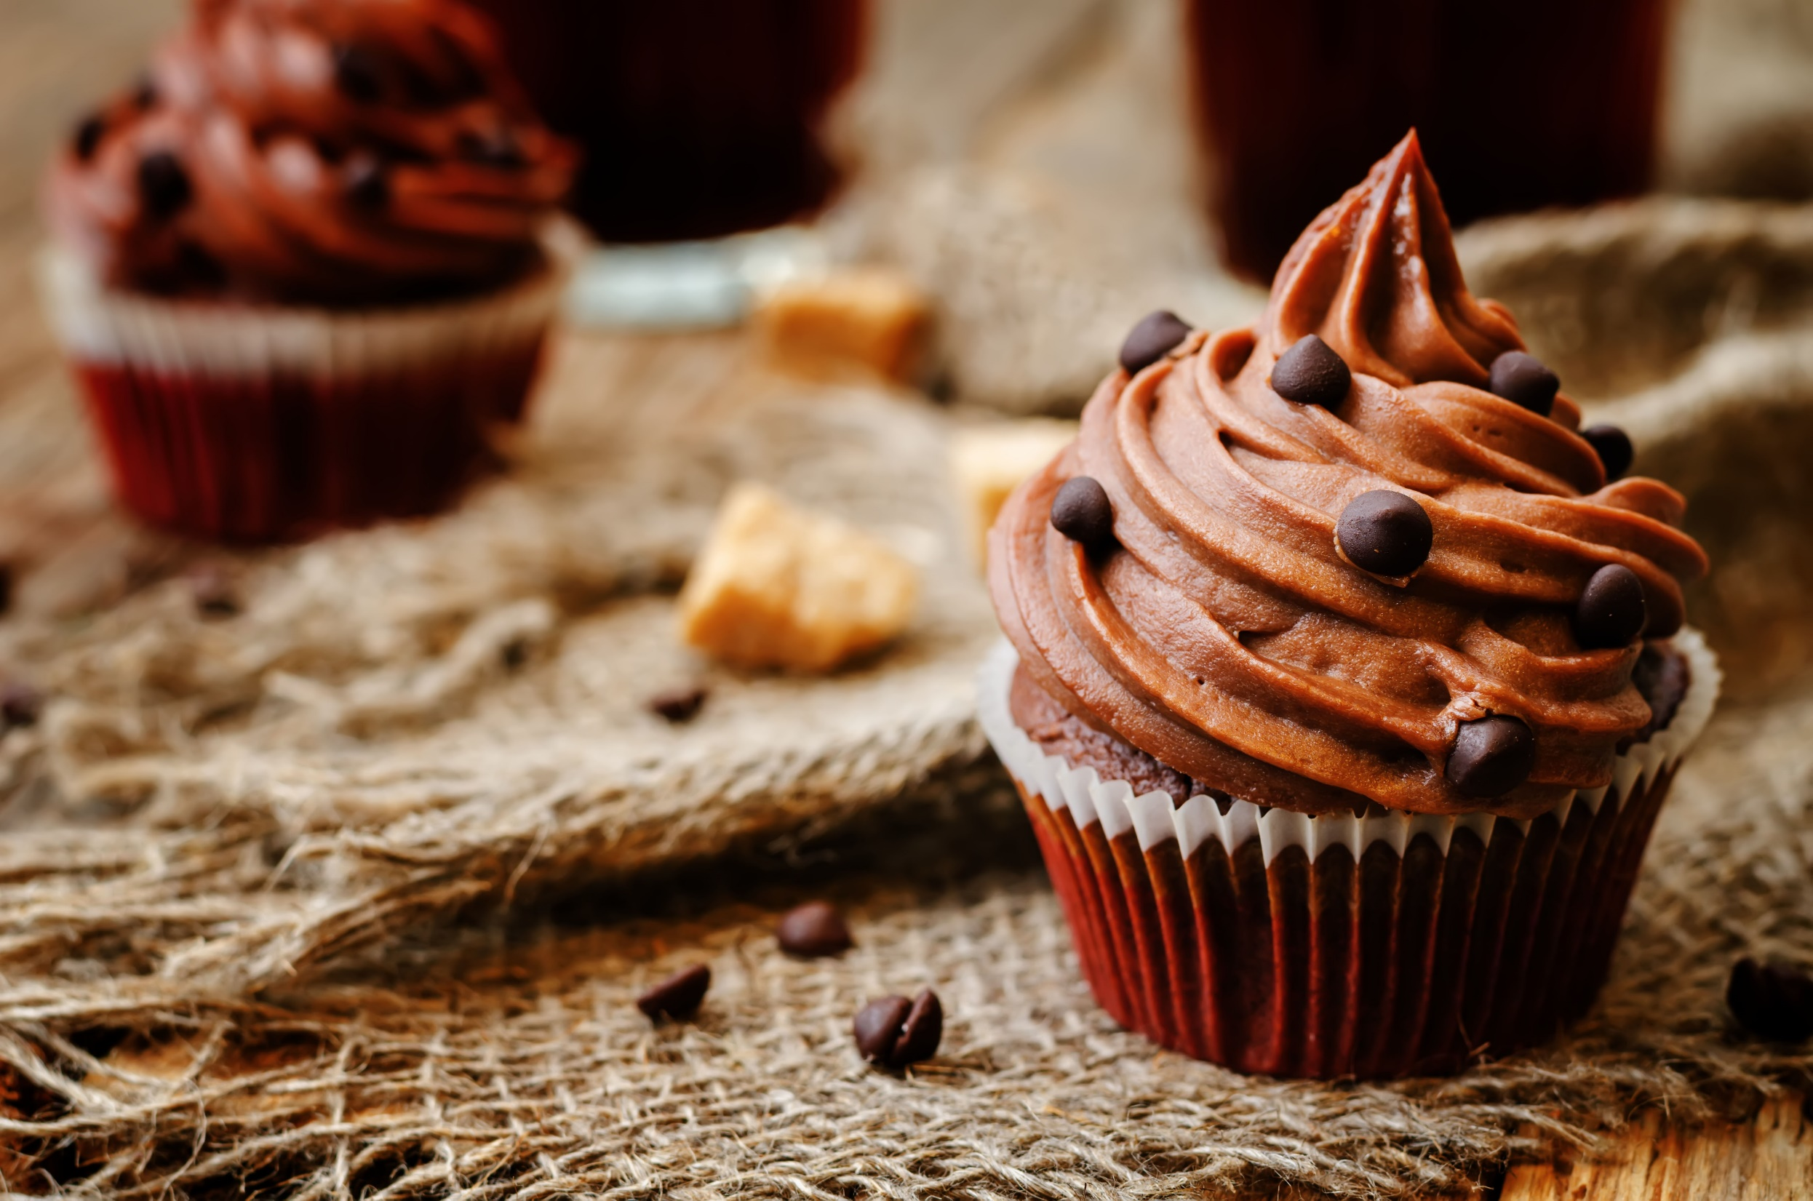
200
calories
Chocolate cupcake

Slide 4


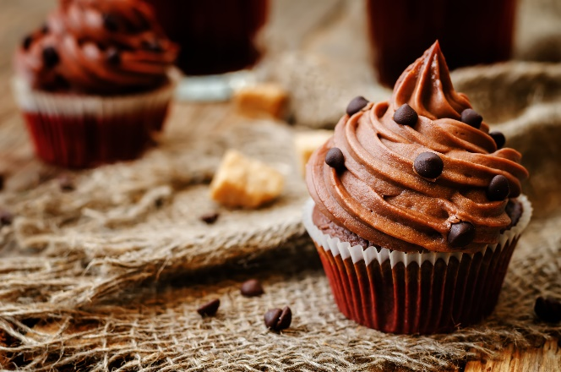
Afternoon snack
Dinner
725
calories
Bedtime snack

Slide 5
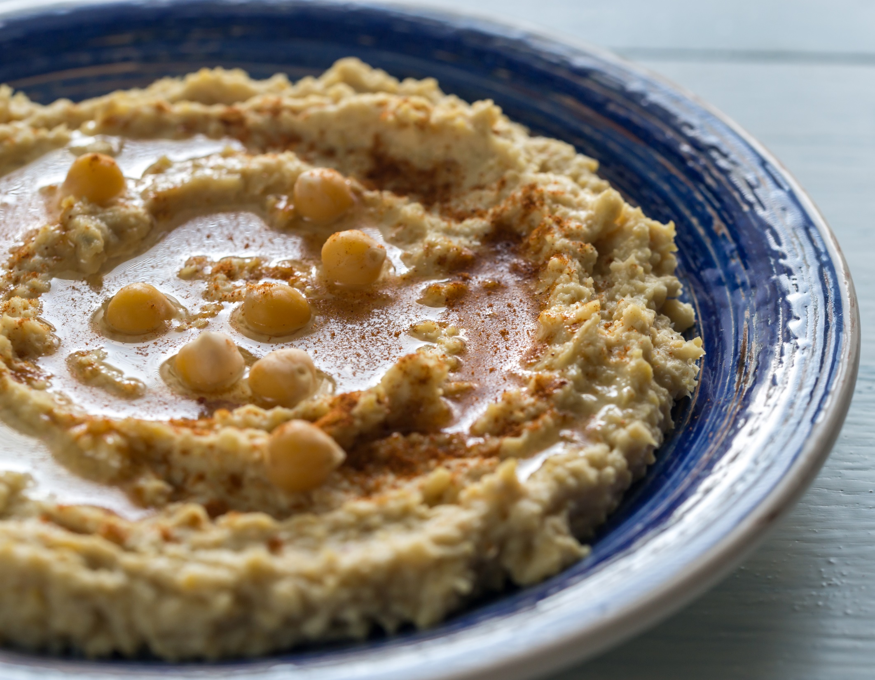
100
calories
Hummus and baby carrots

Slide 6
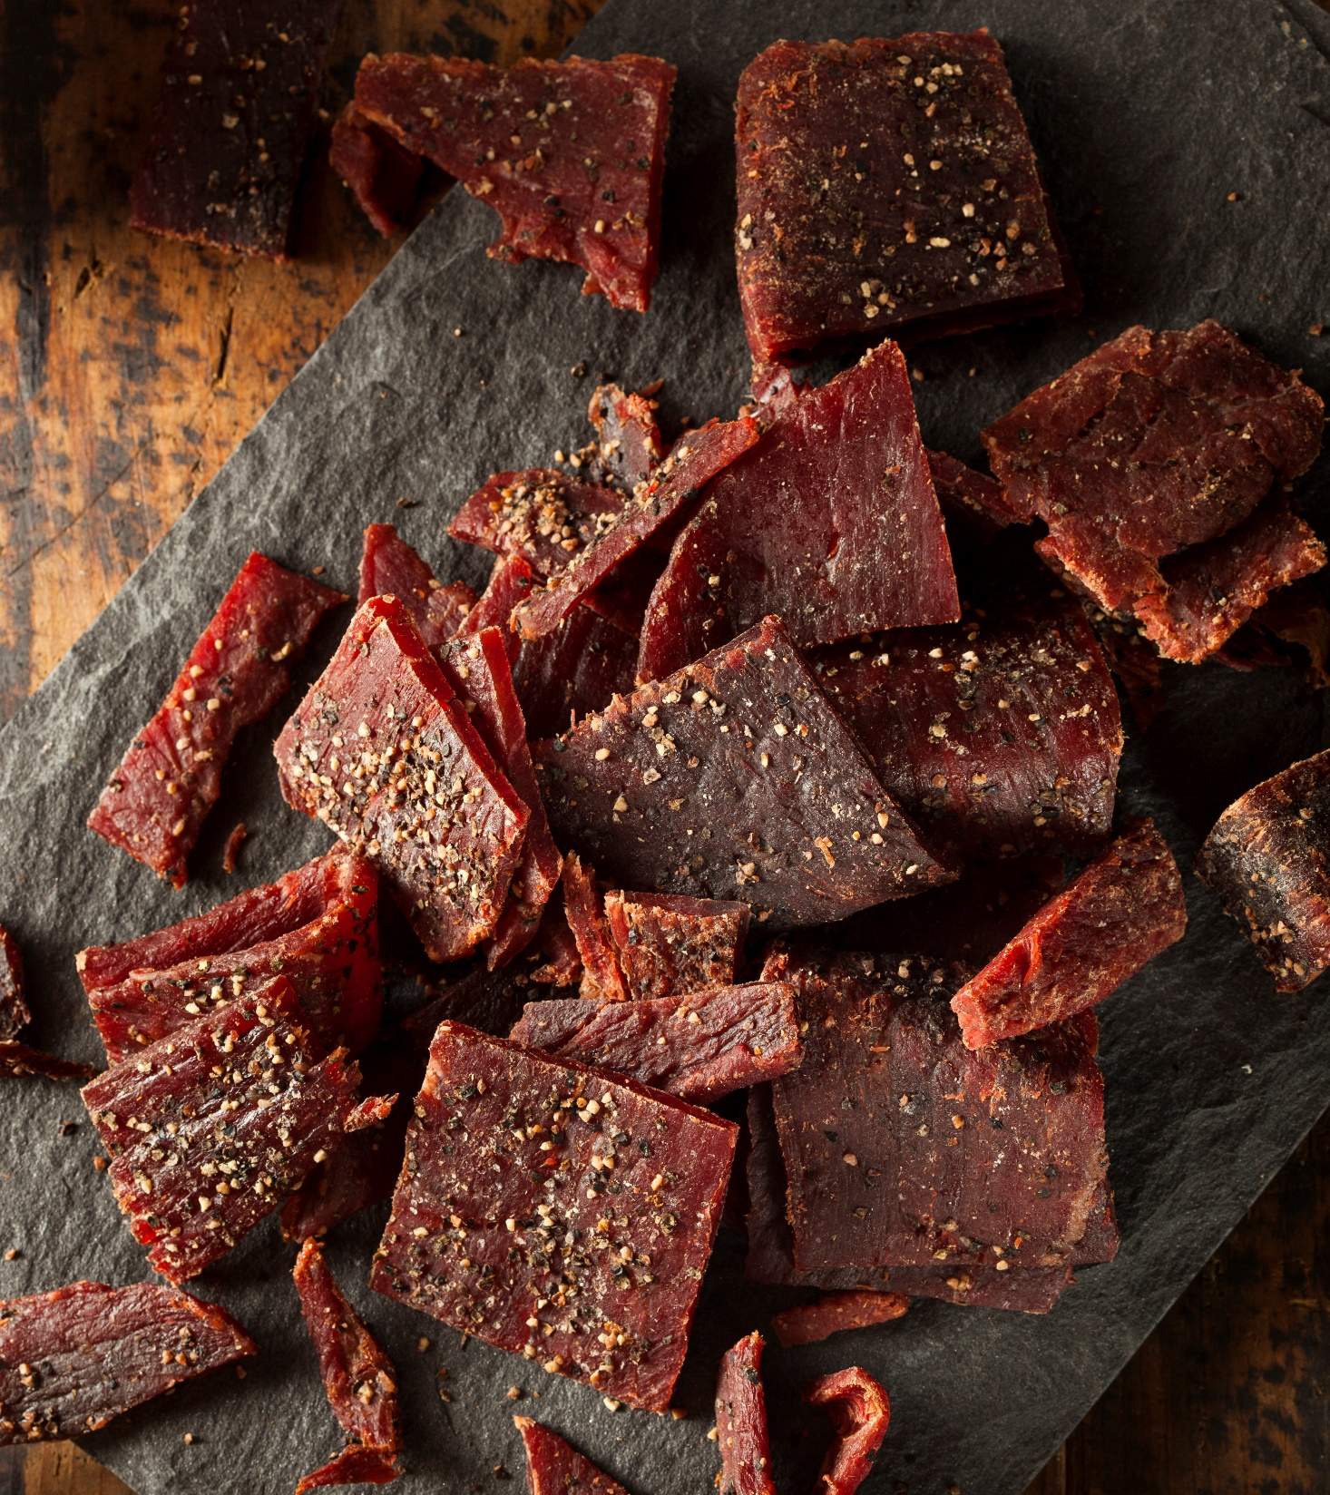
80
calories
Jerky

Slide 7
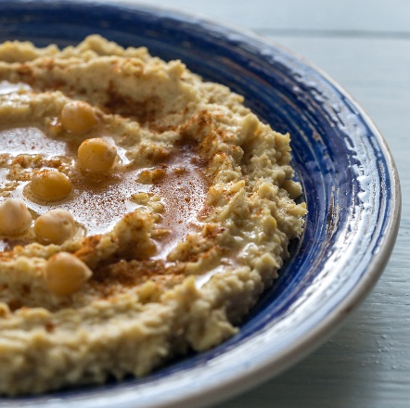
Dinner
825
calories
Bedtime snack

Slide 8
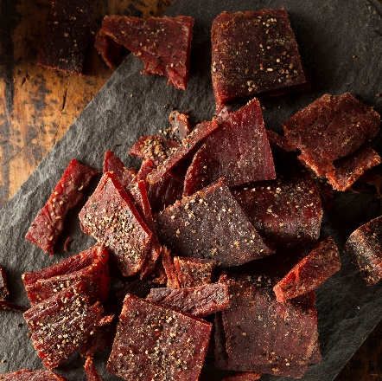
Dinner
805
calories
Bedtime snack

Slide 9
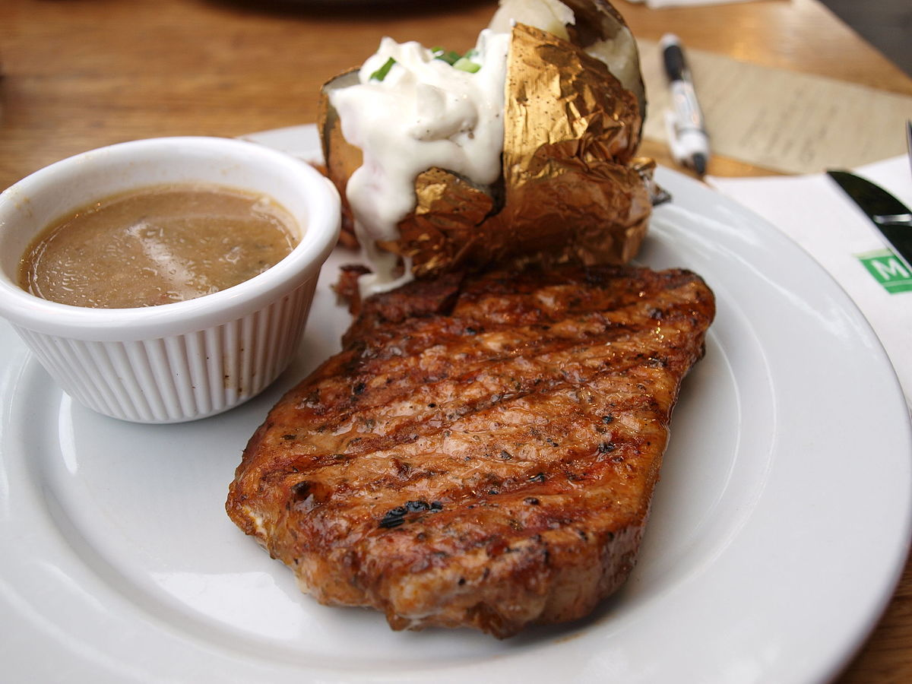
550
calories
Steak, baked potato, salad, and roll

Slide 10
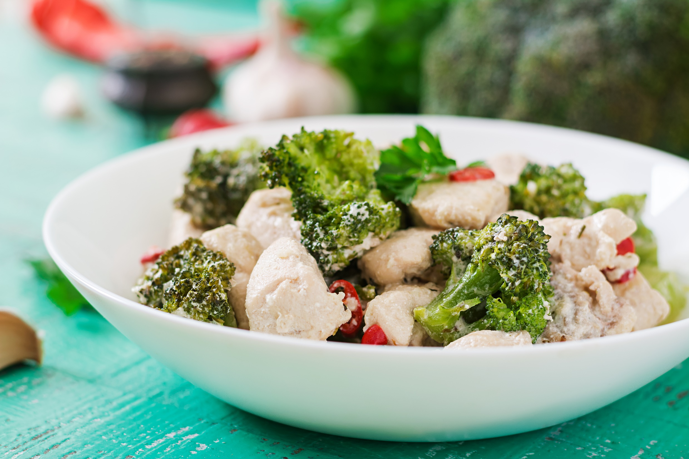
250
calories
Chicken and broccoli in garlic sauce

Slide 11
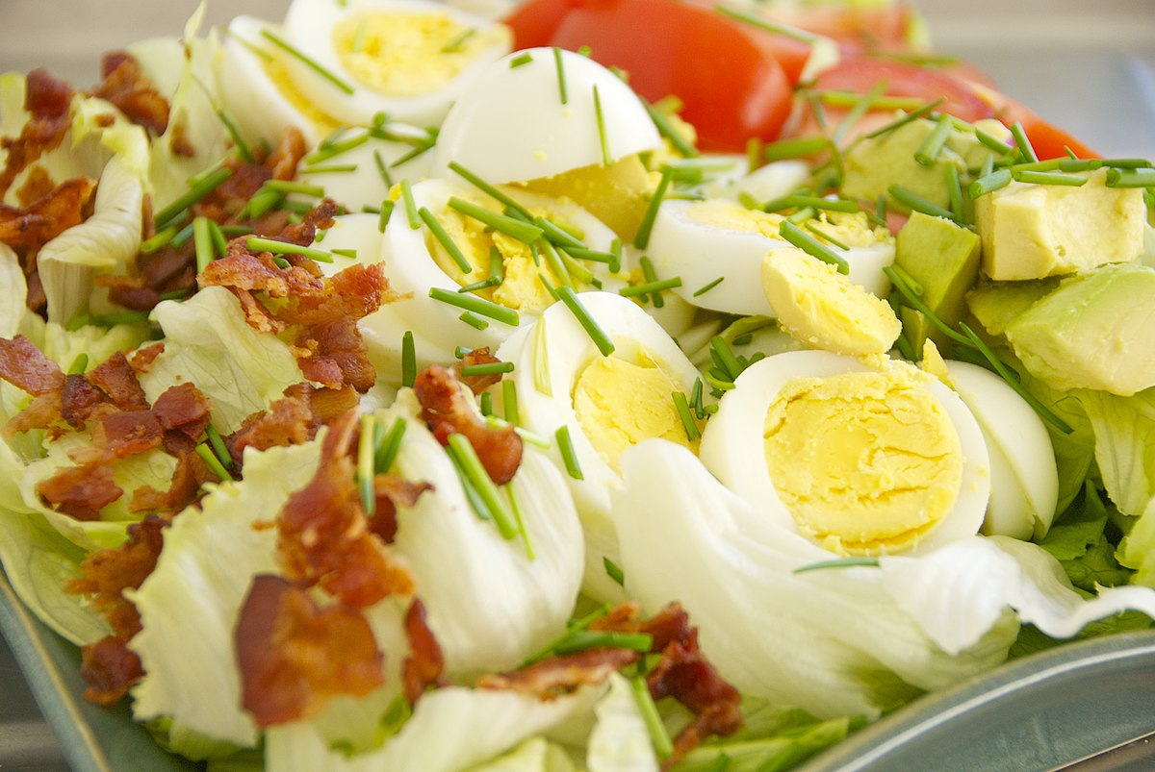
300
calories
Cobb salad

Slide 12
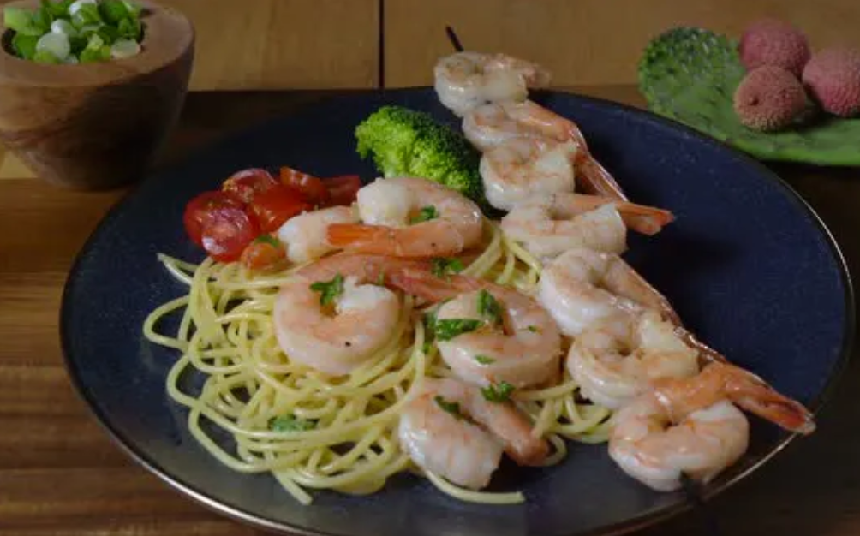
420
calories
Shrimp scampi

Slide 13

1150
calories
Bedtime snack

Slide 14
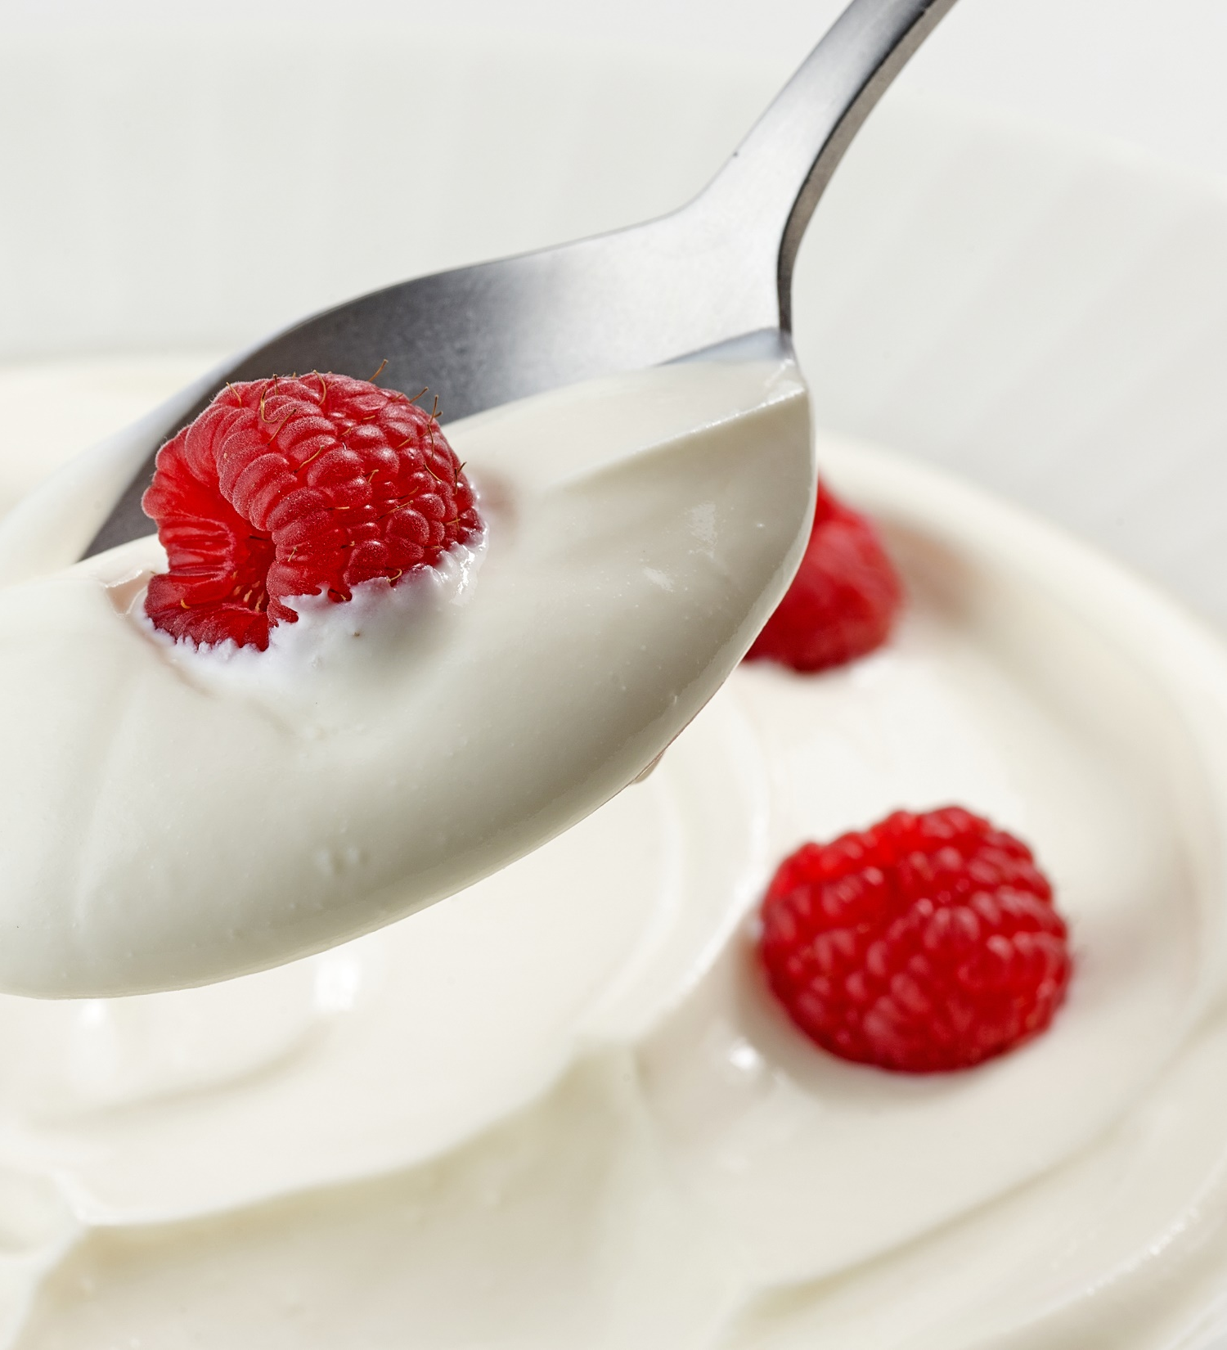
105
calories
Greek yogurt with raspberries

Slide 15
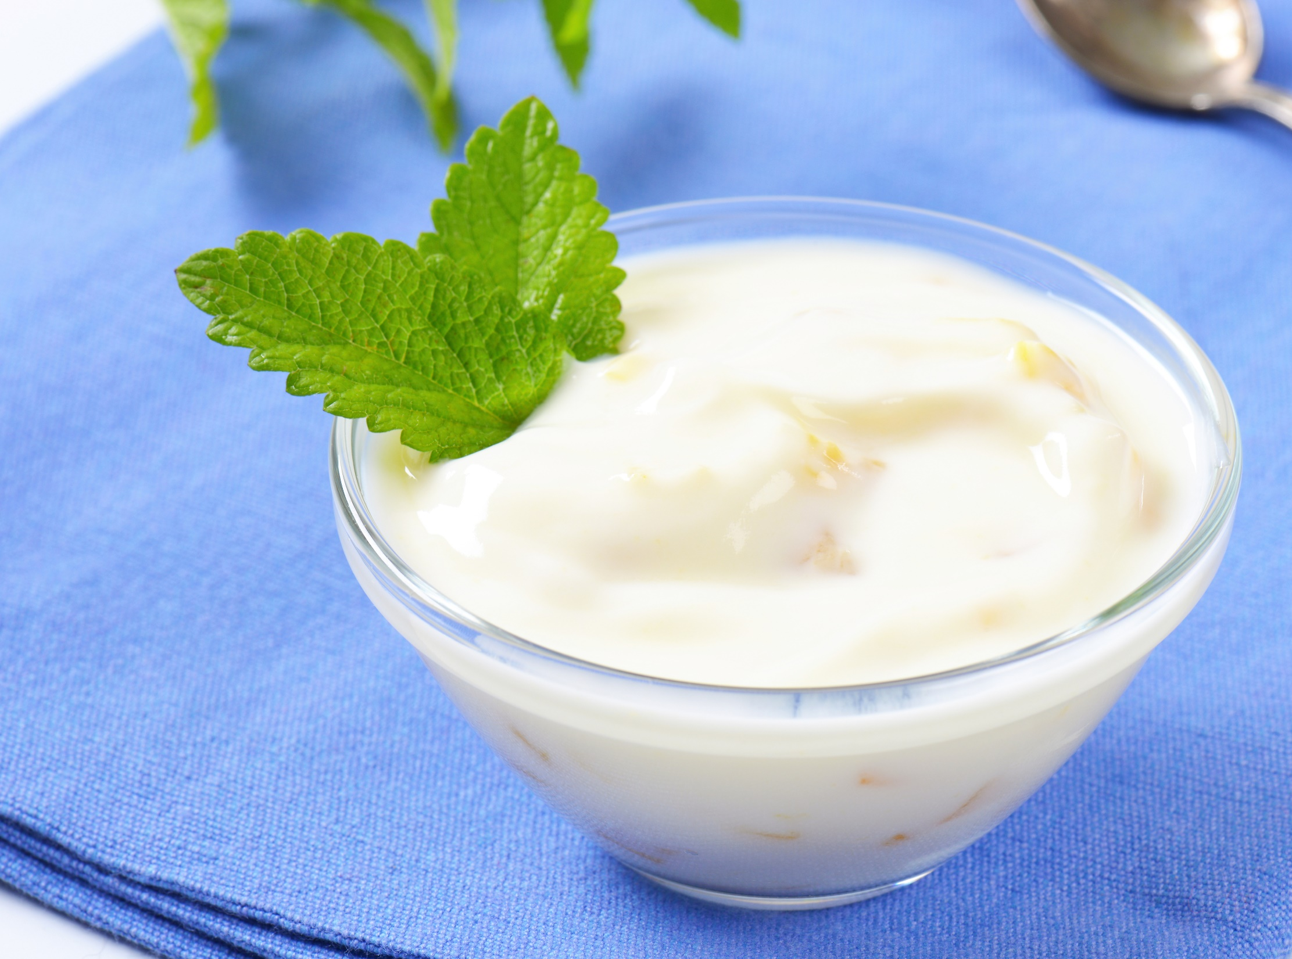
125
calories
Greek yogurt with peaches

Slide 16

1275
calories

